Slide 1
SUMMER SCHOOL ON COMPUTER VISION, GRAPHICS AND IMAGE PROCESSING. ECSU, ISI, KOLKATA.

Slide 2
Automatic Handgun Detection in Images using Deep and Traditional Machine Learning
Sandipan Sarma
Indian Institute of Engg. Science & Technology, Shibpur
Pushan Banerjee
Jadavpur University, Kolkata
Souvik Saha.
University of Calcutta, Kolkata

Slide 3
Contents
Motivation
Approaches
Methodology
Challenges
Conclusions and Future possible Extensions
References
Questions…????

Slide 4
Motivation
A. Apply Deep Learning methods Like CNN - improves real time object detection.
B. Rapid detection and identification of handheld pistols, guns etc. from surveillance data, images…

Slide 5
Approaches
We followed two approaches :
i. Faster RCNN– to device a handgun detector.
ii. SVM for classification using SIFT decriptors.

Slide 6
Methodology

Slide 7
WHY CNN??
CNNs automatically discover increasingly higher-level features from data.
Proper training however, requires very large datasets, in the order of millions of samples, as well as High Performance Computing (HPC) resources, e.g., multi-processor systems accelerated with GPUs.
Notes:
2. Fewer memory requirements In this same case where we use a fully connected layer to extract the features, the input image of size say 32x32 and a hidden layer having 1000 features will require an order of 10⁶ coefficients, a huge memory requirement. In the convolutional layer, the same coefficients are used across different locations in the space, so the memory requirement is drastically reduced.

Slide 8
WHY FASTER r-CNN
Faster R-CNN addresses this issue by implementing the region proposal mechanism using the CNN.
Makes region proposal network(RPN) a part of the CNN training and prediction steps.

Slide 9
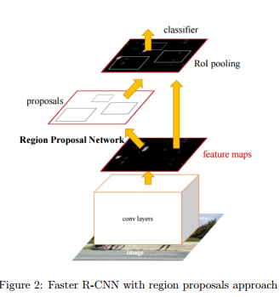
Flow chart of Faster R-CNN
Load the data set
Design the CNN
Configure training options
Train faster R-CNN object detector
Evaluate the trained detector

Slide 10
Experiment using Faster R-cnn
DATASET:
Our experiment uses a small handgun data set that contains 100 images.(Training images 70% and test images 30%).
NETWORK USED:
In the data set all the objects are larger than [16 16], so an input size of [32 32] is selected .
Here 3 convoluted layers with relu is being used.
The final layers of a CNN are typically composed of fully connected layers and a softmax loss layer

Slide 11
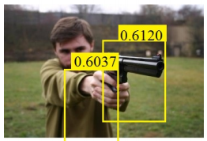
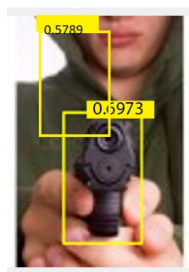
RESULTS FOR FASTER R-CNN
The method gives us the bounding boxes for our desired object (handgun in this case), along with a score which indicates the probability of being a handgun.

Slide 12
SVM classifier Method Using Sift Descriptors
SVM Classifier.
SIFT Technique.
Using SVM on SIFT Descriptors

Slide 13
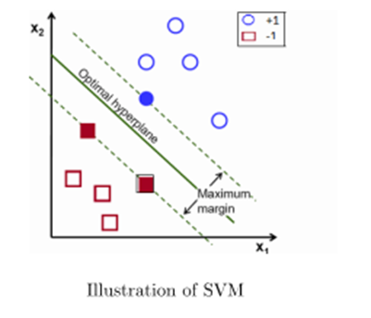
Why SVM???
SVM uses linear models to implement nonlinear class boundaries - transforms the input space using a nonlinear mapping into a new space (F feature space).
Then a linear model constructed in the new space can represent a nonlinear decision boundary in the original space.

Slide 14
Advantages / Disadvantages (SVM)
Advantages:
1. Produce very accurate classifiers.
2. Less over fitting, robust to noise.
Disadvantages:
SVM is a binary classifier. To do a multi-class classification, pair-wise classifications can be used (one class against all others, for all classes).
Computationally expensive, thus runs slow.

Slide 15
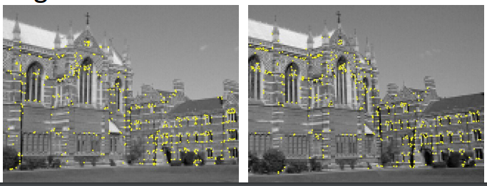
What is SIFT?
It is a technique for detecting salient, stable feature points in an image.
For every such point, it also provides a set of “features” that “characterize/describe” a small image region around the point. These features are invariant to rotation and scale.

Slide 16
SIFT ALGORITHM
• Determine approximate location and scale of salient feature points (also called keypoints)
• Refine their location and scale
• Determine orientation(s) for each keypoint.
• Determine descriptors for each keypoint.

Slide 17
SIFT Descriptors
Data Set of 100 images taken
70% of data set taken for training.
30% kept for testing.
Generate key points, key points location,
Key point descriptors (here we got 21073 for 70 images)

Slide 18
Using SVM on SIFT Descriptors generated
Keypoint descriptors
Kernels are varied for various results.
Linear-
Gaussian- 0.25 precision; 0.48 recall
Polynomial-0.26 precision; 0.86 recall
SVM (run on training data)

Slide 19
Experiment using SVM on SIFT DESCRIPTORS
* DATASET:
The dataset used in our experiment consists of 70 images where 70% of the images used for the training dataset and 30% used for the test data. Here 70 images are our training set from where the SIFT descriptor extracts the descriptor for the key points. A matrix of 21073 rows and 128 columns of the descriptor values is obtained (each descriptor is a 128-element vector).

Slide 20
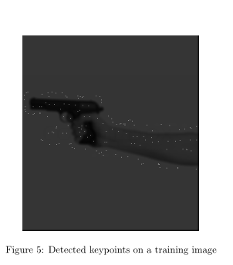
Detected Keypoints on training image

Slide 21
Experiment using SVM on SIFT DESCRIPTORS (contd.)
Process:
Among the detected keypoints for a training image, the ones falling within the RoI are labelled as foreground descriptors, while the rest are labelled as background descriptors. Since the number of background descriptors is very high compared to that of foreground descriptors, we randomly select 1800 descriptors from each of the classes to train the SVM classiﬁer.

Slide 22
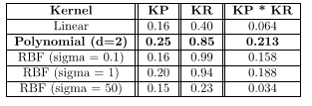
Why Choose Polynomial Kernel for SVm over others?

Slide 23
RESULTS FOR SVM
SVM classiﬁed the descriptors quite well, and then bounding boxes were generated for each test image, as in the previous case. The resulting boxes were somewhat larger than the handguns present in the images, but almost all of them detected the handguns inside them. Polynomial kernel is used for this classiﬁcation and 61.9% accuracy is obtained.

Slide 24
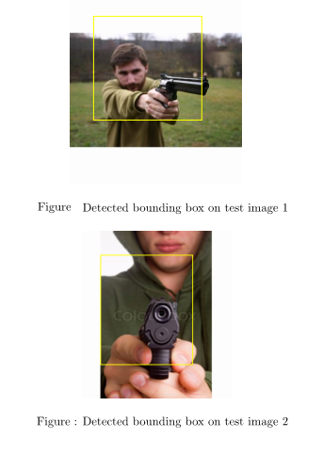
RESULTS FOR SVM (CONTD)

Slide 25
Notes :
The precision and recall values are always better using any kernel for the -1 labelled data
The cost ratio in C for +ve/-ve samples are made to be varied
In cases of the Gaussian function being used we are required to vary the value of sigma.

Slide 26

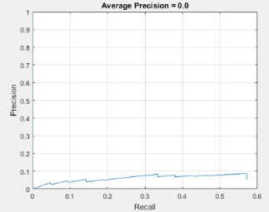
Why SVM+SIFT Proved to be better than Faster R-CNN in our case?
FOR Faster R-CNN

Slide 27
Challenges
1. The event in which a weapon or part of a weapon is hidden from view by another object (e.g. another hand) or an issue pertaining to the surrounding environment (e.g. poor lighting)
2. There are a variety of different types, shapes, and sizes of weapons, leading to a variety of different image sizes and bounding box sizes.
3. The limited resources and the moderate computer GPUs restricted our training set.

Slide 28
CoNCLUSION AND FUTURE POSSIBLE EXTENTIONS
Both the models- Faster R-CNN and SVM with SIFT were ran on the same environment and their properties were compared.
Both approaches are independent of the image size. The poor performance observed for Faster R-CNN is due to the small training dataset and due to less number of convolutional layers. But one advantage of this method is that it is likely to be able to detect multiple handguns if trained properly.
On the other hand, the SVM and SIFT descriptor reliant approach, while producing good results on the test images, cannot be directly applied for images with multiple guns.
A future research direction may be to combine these approaches to overcome the short-comings of both.

Slide 29
References:
[1] Roberto Olmos, Siham Tabik and Francisco Herrera, ”Automatic handgun
detection alarm in videos using deep learning”, Soft Computing and
Intelligent Information Systems research group, February, 2017.
[2] Shaoqing Ren, Kaiming He, Ross Girshick and Jian Sun, ”Faster R-CNN:
Towards real-time object detection with region proposal networks”, in Advances
in Neural Information Processing Systems 28 (NIPS 2015).
[3] Kaiming He, Xiangyu Zhang, Shaoqing Ren, and Jian Sun, ”Spatial pyramid
pooling in deep convolutional networks for visual recognition”, in European
Conference on Computer Vision (ECCV), 2014.[4] R. Girshick, ”Fast R-CNN”, in IEEE International Conference on Computer
Vision(ICCV), 2015.
[5] David G. Lowe, ”Distinctive Image Features from Scale-Invariant Keypoints”,
in International Journal of Computer Vision, volume 60, issue
2, pp 91-110, November 2004.

Slide 30
QUESTIONS ?????

Slide 31
Thank YOU

